Slide 1



PART : Pre-trained Authorship Representation Transformer
Capstone Project Phase 1
Presenting:
Tuval Zitelbach 316219633 Meitar El-Ezra 318608742
Notes:
Hi, our names are...
We are here to present to you the first part of our project focusing on a model named PART : a pre trained authorship representation transformer

Slide 2
What are we going to discuss:
Problem definition
PART model’s architecture
UML diagram for GUI
GUI
Tests table for GUI
Notes:
We are going to define the problem the model aims to solve.
We are going to present the architecture of the PART model.
Then we’ll talk about the GUI we’ll develop for testing the model:
We’ll display a UML use-case diagram for the interface, the interface itself, and the tests to be performed on it.

Slide 3
Problem Definition
Notes:
So, let’s define the problem

Slide 4
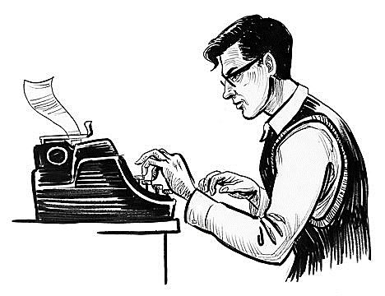

Documents written by the author
Author
D1
PART model
D2
. . .
Dn
ek | … | e3 | e2 | e1
ek | … | e3 | e2 | e1
… | … | e3 | e2 | e1
ek | … | e3 | e2 | e1
E1
Similarity (E1, En) = MAX
E2
En
Authorship embeddings
Notes:
This is a general flow of the idea, so we can understand how the model would operate.
There is an author.
he wrote some documents.
The documents can be inserted to the PART model.
The model will produce matching embedding vectors for each document.
Those vectors are named Authorship Embeddings.
When checking the similarity of 2 of the embeddings of the documents, we will get a MAX value.

Slide 5
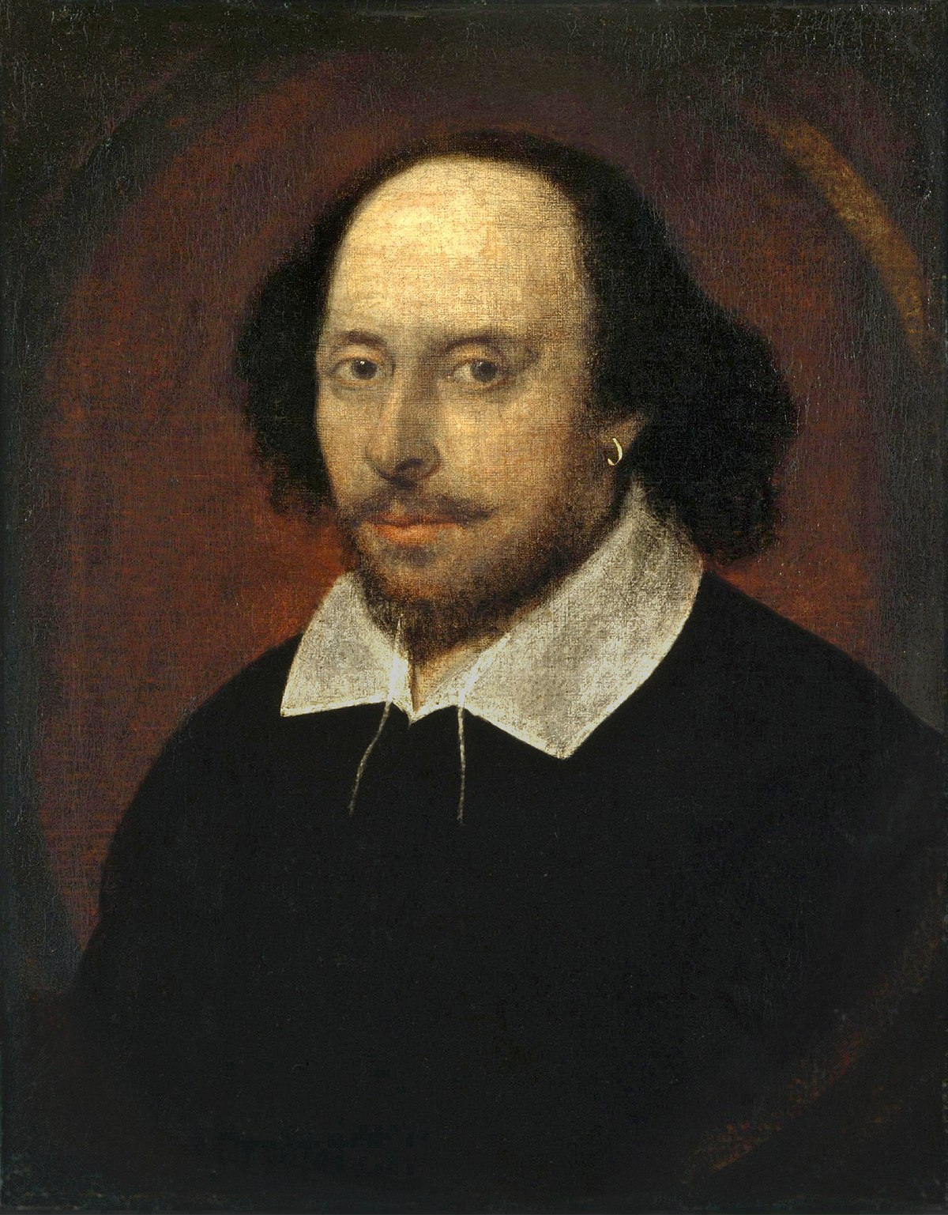


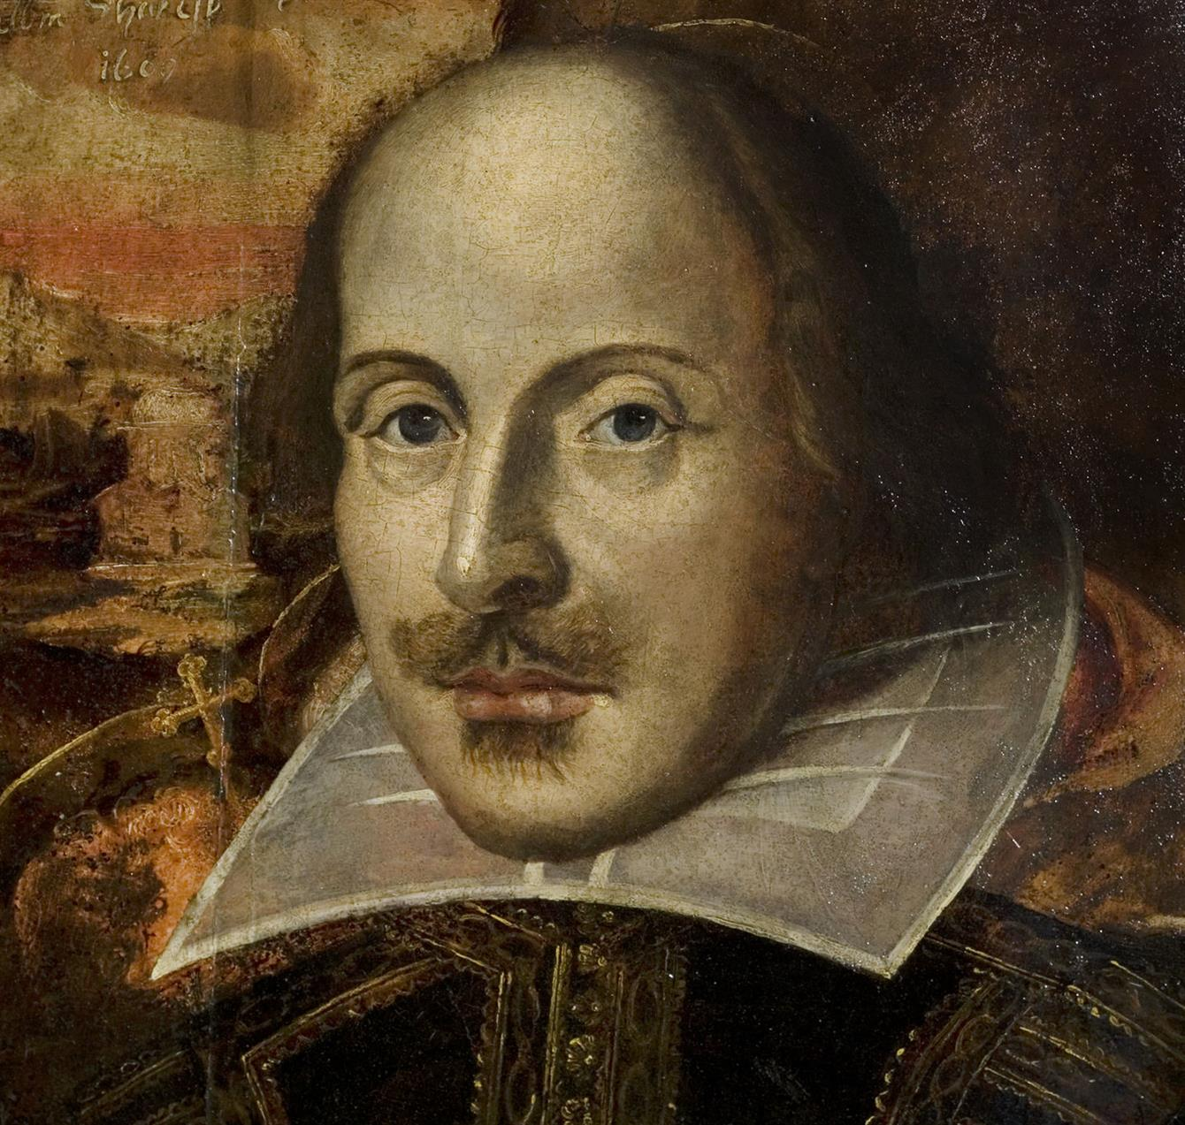

Project’s goal: Plagiarism Detection
Specifically for texts written by Shakespeare or from the old testament.
PART model
E
ek | … | e3 | e2 | e1
PART model
Notes:
In this project, our goal is to be able to detect plagiarism done with works written by William Shakespeare or taken from the old testament.
Plagiarism is when a text written by a certain author, is “stolen” and signed by someone else.
What is going to happen is that the model, that can attribute authorship, will recognize the writing style of Shakespeare (for example)
so when fed with a text Shakespeare wrote but signed by someone else or anonymously,
it would produce the same embedding and uncover the theft.

Slide 6

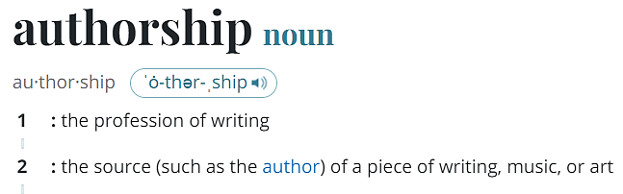
Notes:
The main topic of this project is a task called authorship attribution.
In order to understand what is authorship attribution, we first need to understand what is authorship.
So, according to the Merriam- Webster dictionary, there are 2 definitions for “authorship”: The first meaning is The profession of writing.
The second is the source of a piece of writing.
We are going to focus on the second meaning, who wrote a text.

Slide 7
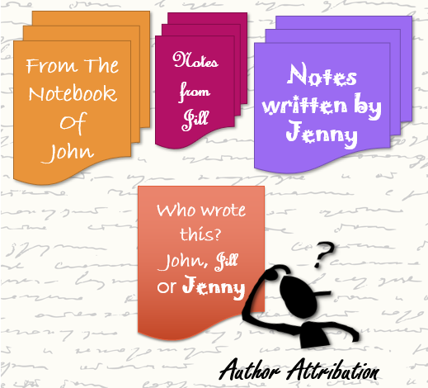
Authorship Attribution
The goal of authorship attribution is to identify the most likely author of an anonymous document among a set of known candidate authors.
Notes:
The goal with the task of authorship attribution is to identify an author of a document.
Like it the picture. You can see there are 3 sets of texts, written by John, Jill and Jenny.
We want to find out who wrote the red note according to what we can learn about them from their texts.

Slide 8
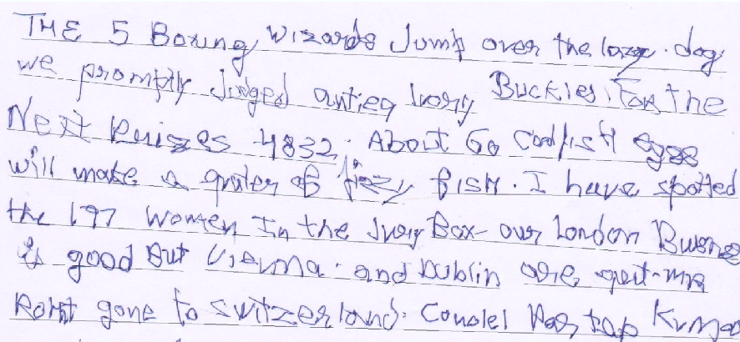
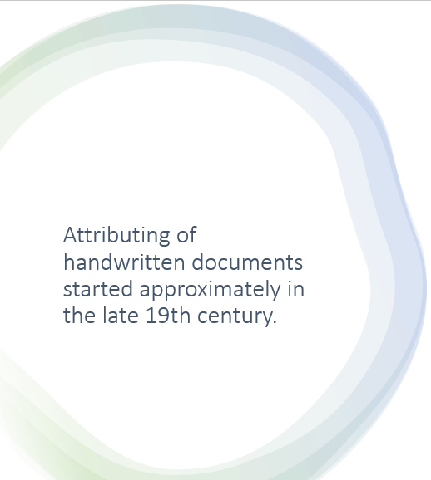
Attributing of handwritten documents started approximately in the late 19th century.
Notes:
This task is not a new one, it is practiced for over 200 years.
But it was focusing on the data that existed at the time, which is handwritten documents.

Slide 9

However , nowadays most textual data is digital.
Notes:
But today most textual data is digital so how do you identify a document’s writer in this situation ?

Slide 10

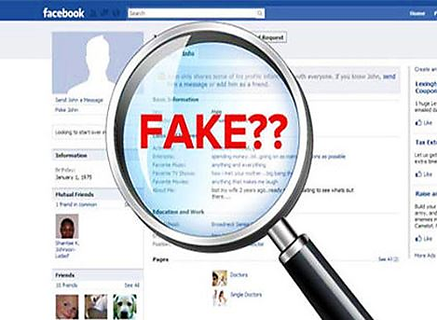
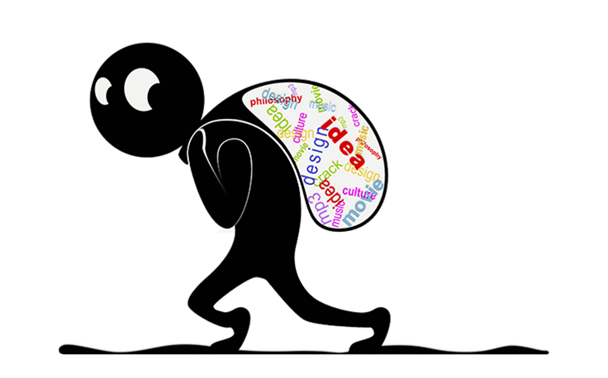
Analyzing those attributions can contribute to several fields, such as forensics, plagiarism detection, social networks analysis, identifying fake news or profiles and more.
Notes:
Among the fields that would profit from the ability to attribute authorship we have:
Forensics and linguistics for example,
Social network analysis, identifying fake news and profiles,
Plagiarism detection and more

Slide 11

Authorship Attribution Real Example
By using 4 different linguistic variables such as the distribution of word lengths and the frequency of 100 most common words, the analysis pointed strongly to J. K. Rowling as the true author of the book.
Notes:
A real life example of authorship attribution is this little story, in which the famous author JK Rowling was identified as the writer of the book : The Cuckoo’s Calling, which she wrote under a pseudo-name.
The people who found out used 4 different linguistic variables such as the distribution of word lengths and the frequency of 100 most common words, and were able to relate them to Rowling.

Slide 12

What are Authorship embeddings?
An authorship embedding is a representation of a documet’s author’s style as a numerical vector.
Authorship embeddings are generated by a semi-supervised contrastive learning approach.
Notes:
So what are those authorship embeddings ?
An authorship embedding is a representation of the writing style of the author of a document.
it is a numerical vector.
The authorship embeddings are generated by a semi supervised contrastive learning approach.

Slide 13

Generating the vectors is to project authors’ documents onto an authorship-aware hyper-space. ⇒ each document representation will be aligned towards the document’s author and not its contents.
Notes:
The embeddings are vectors that project a document onto an authorship-aware hyper space.
A point in that space is an embedding and a representation of the document’s author’s style.
So, the embeddings are aligned to the author and not to the content of the given documents.
This graph for example, is taken from the original paper that introduced the authorship embeddings.
We are expecting that, like in the graph, embeddings of texts from the same author will be close to each other.

Slide 14


Each embedding Ei represents textual documents embedded in a numerical space. Ideally, the embedding will encode the features from the author by generating the same representation for different texts.
Author: i
Di
Ei
ek | … | e3 | e2 | e1
D’i
Notes:
If the system works perfectly, we can take 2 different documents of the same author, and the model will produce the same authorship embedding for them.

Slide 15
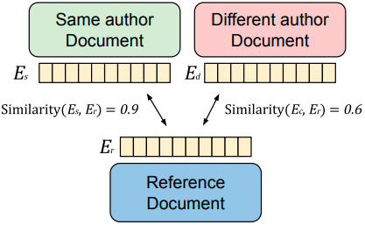
Authorship Embedding contrastive learning
Example of a comparison of authorship embeddings.
When compared with a similarity function, the related document similarity should be higher than an unrelated text.
Notes:
The vectors are generated by a contrastive learning approach.
This means that during training, the model is comparing pairs of positive and negative embeddings.
It uses the blue document as a reference for the comparing.
If we start with a positive sample, we compare the reference document with a document that has been written by the same author. Then the similarity function in the model would output a high value .
For a negative sample, we take a documents from a different author. Then the similarity function would output a lower value.

Slide 16
A W. Shakespeare piece
Plagiarism suspect
Authorship Embedding contrastive learning
It is helpful for our project because, if plagiarism is performed, the model would be able to help detect it, as displayed:
A W. Shakespeare piece
Notes:
So for example, if we take a piece written by William Shakespeare as a reference and another document Shakespeare wrote we will get a high score.
The same thing will happen if we take a text somebody stole from Shakespeare, it would get a high score as well !
This way, plagiarism can be detected.

Slide 17
Architecture
Notes:
We now move on to the architecture that produces the authorship embeddings

Slide 18
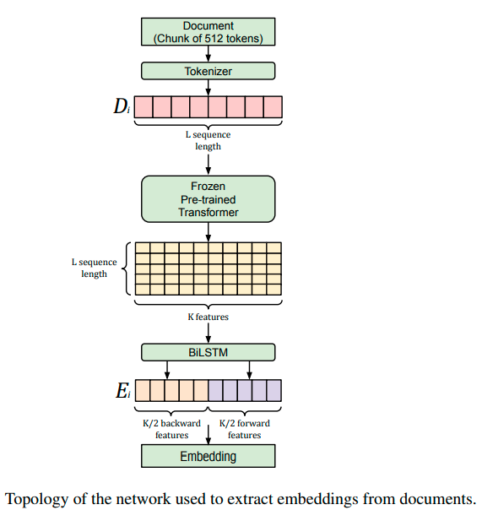
Pre-processing of the data
Semantic Word embeddings production
Authorship embeddings production
Notes:
The architecture is based on three important phases:
Pre processing of the data
Word embedding production
And
Authorship embedding production which is the final output.
We will now delve into each part.

Slide 19

Pre-processing In Natural Language Processing
Raw text data might contain unwanted or unimportant text so, our results might not give efficient accuracy and might make it hard to analyze. So, proper pre-processing must be done on raw data.
Notes:
The text of the document is the input data of the model.
It can contain unwanted parts. When continuing to work on the data, if we don’t prepare the text and deal with those parts, the results we will get can be inaccurate.

Slide 20
Tokenization
Punctuation removal
Numbers removal
Stemming
Lemmatization
Pos tagging
Stopwords removal
HTML tags removal
Text preprocessing
Notes:
Document preprocessing may include steps like tokenization, lowercasing and spelling correction.

Slide 21
Pre-processing of the data
Notes:
So, for our task, for the first phase in the architecture :the data is divided into chunks, which are later tokenized. Afterwards we have L tokens.

Slide 22

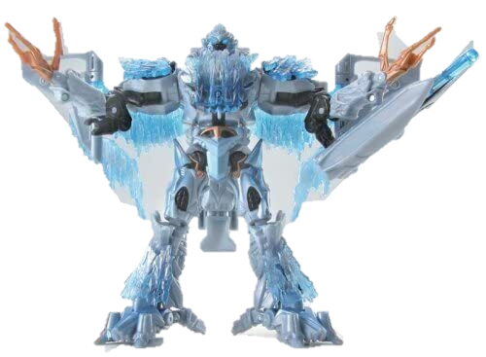
Frozen transformer
The main goal of the frozen transformer is to extract features for training the model, with speed, from the L tokens it is given.
Therefore, while training the model, the layers of the pre-trained transformer are being frozen, meaning the weights of the transformer are kept unmodified.
Notes:
Continuing to the second phase of the architecture :
The tokenized chunks of data are fed into a frozen transformer.
When a transformer is frozen it means the weights of layers in the pre-trained transformer are not changing.
It can work faster that way, and in this project, it helps with extracting features from the tokens.

Slide 23
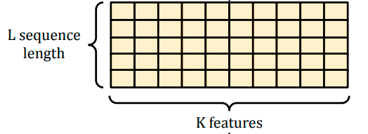

A semantic word embedding is a semantic word representation as a K dimensional vector, preserving the linguistical properties of the word.
Frozen transformer
For each of the L tokens
Notes:
The frozen transformer produces semantic word embeddings.
These are vector representations of the linguistic properties of the tokens.
So we take each of the L tokens, feed it to the transformer and generate a K sized semantic word embedding, until we have a matrix of dimension LxK

Slide 24




Transfer Learning for Feature Extraction
A method where a model developed for a task is reused for a model on another task.
In this project’s case we extract features from the frozen transformer that learned to interpret language, and use them to produce the authorship embeddings.
Notes:
Transfer learning is a method where you repurpose a model that’s trained in a certain task, and use it for a different task.
We use transfer learning in PART architecture.
We use the result of the frozen transformer, the semantic word embeddings, and shift them to capture the style of the author. to create the authorship embeddings.

Slide 25

BiLSTM
A BiLSTM network is a common tool to catch text meaning. Each K sized word embedding is past through the forward and backward LSTM passes of the BiLSTM.
The output is the authorship embedding.
Notes:
Now we have reached the third and last phase of the PART architecture:
We pass the semantic word embeddings through a BiLSTM network.
BiLSTM network is used for obtaining text meaning.
The word embedding passes through the BiLSTM – through the forward pass and through the backward pass
And the result of that process is a K sized vector, which is our final AUTHORSHIP EMBEDDING.

Slide 26
The model would train on a dataset containing works of William Shakespeare, other known authors.
Training dataset
Documents written by other authors | Documents written by Shakespeare
Notes:
The model will train on a dataset that includes works of different authors.
For example, for our purposes, it will have documents written by W. Shakespeare and by other authors as well.

Slide 27

Experimentation in part B
This process would be repeated at least 3 times: 1. The documents from the dataset would be chosen randomly and divided in the ratio of 90% : 10% for training and testing, respectively.
2. train the model with the training set.
3. predict authorship embeddings on the testing set.
4. save the testing results.
The test results will be compared for future analysis.
Notes:
The documents will be chosen randomly and divided to training and testing sets, say, 90 precents for training and 10 for testing.
The model will be trained on the training set and predict authorship embeddings for the testing set.
This process will be done at least 3 times, each time choosing random documents of the dataset for testing and training.
After all that, the results of the testing rounds will be compared.

Slide 28
UML diagram
Notes:
Now we will present a UseCase diagram describing the system of the GUI that will be developed in part B of the project.

Slide 29
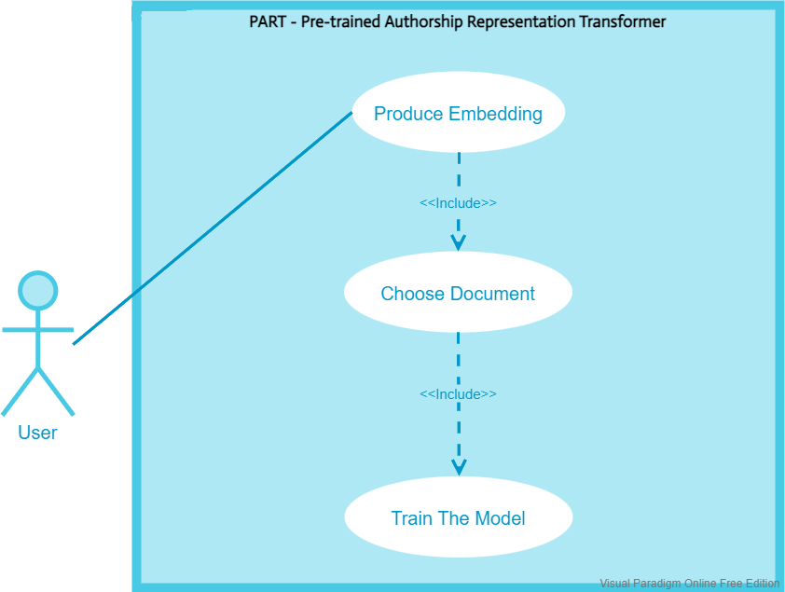
GUI Use-Case diagram
Notes:
This is the UC diagram.
The user can produce an embedding for a document to his choosing, after the model is trained.

Slide 30
GUI
Notes:
We’ll continue to the GUI presentation

Slide 31

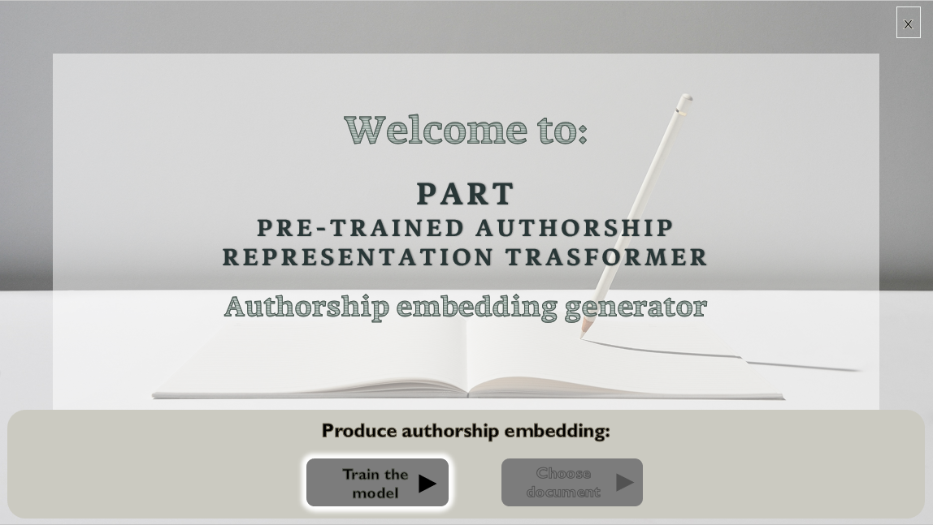
Notes:
Main screen

Slide 32
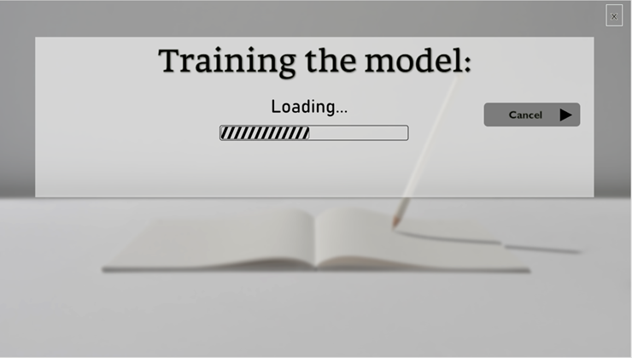
Notes:
Training the model, loading screen:

Slide 33
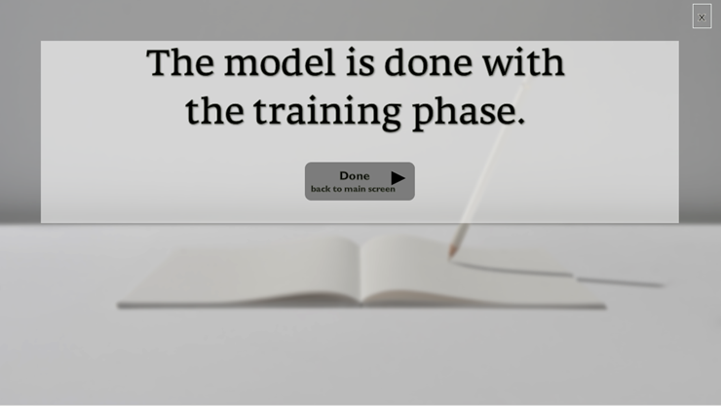
Notes:
Finished training screen:

Slide 34
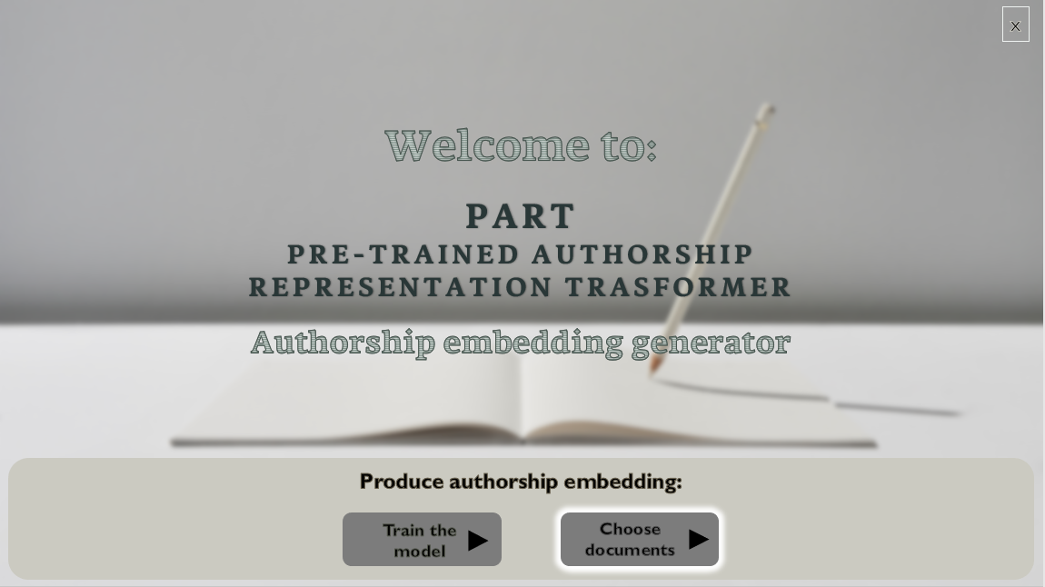
Notes:
Main screen (choosing Training the model):

Slide 35
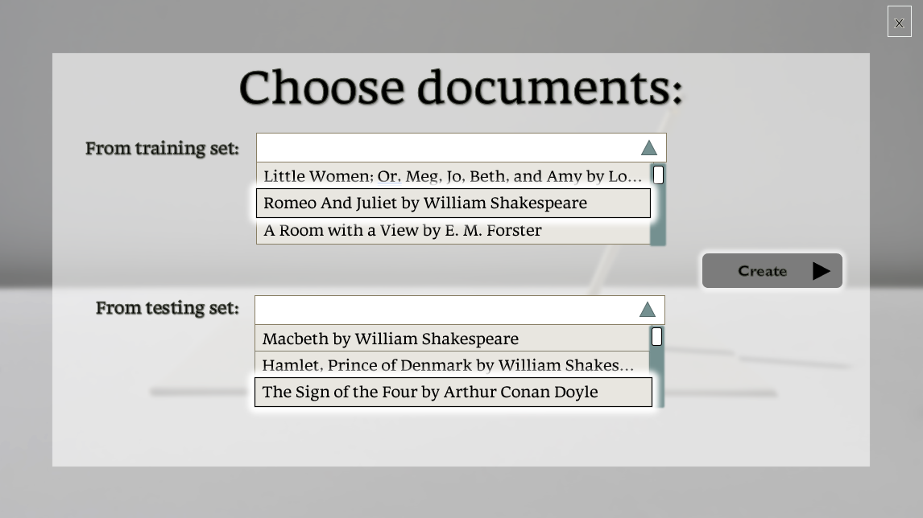
Notes:
Choosing documents screen:

Slide 36
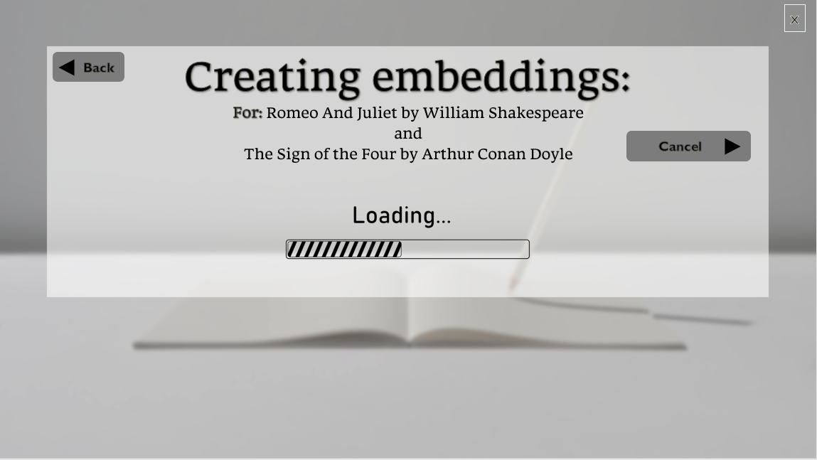
Notes:
Creating an embedding, loading screen:

Slide 37
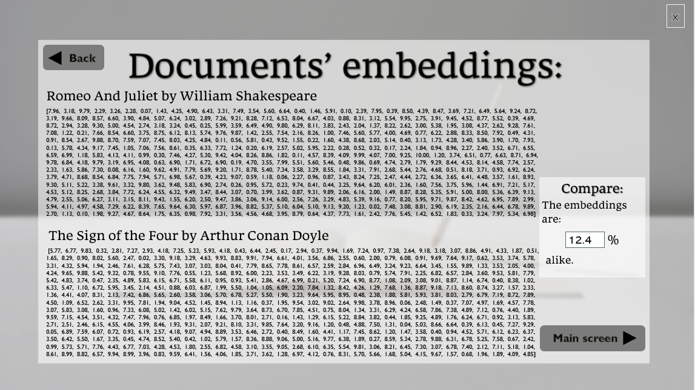
Notes:
Document’s authorship embedding display:
we will subtract one embedding from the other. If it’s written by the same author, the resulting vector would be close to be all zeros.
Otherwise, we can measure the distance between the vectors, divide it by the largest possible distance of values, and get a percentage of similarity.

Slide 38


Test Number | Test Subject | Expected Result
1 | Press "Train The Model” | 'Training loading' window appears when finishes loading, window “Finished training” appears
2 | Press "Done" | “Main Screen” appears
3 | Press “Choose Document” | The window “Choosing Document” appears with disabled “Create Embedding” button.
4 | Select one of the documents from the dropdown list | The button “Create Embedding” is enabled.
5 | Press "Create Embedding" | “Create an Embedding -loading screen” window appears. When finishes, loads window “Document’s authorship embedding display”
6 | Press back | The window “Choosing Document” appears with disabled “Create Embedding” button.
7 | Select different document from the dropdown list | The button “Create Embedding” is enabled.
Tests table
Notes:
This are the test the GUI system will need to pass, each one with it’s expected result.

Slide 39
Test Number | Test Subject | Expected Result
8 | Press "Create Embedding" | “Create an Embedding -loading screen” window appears. When finishes, loads window “Document’s authorship embedding display”
9 | Press “Main Screen” | Return to main screen
10 | Press “Choose Document” | The window “Choosing Document” appears with disabled “Create Embedding” button.
11 | Select one of the document from the dropdown list | The button “Create Embedding” enabled.
12 | Press "Create Embedding" | “Create an Embedding -loading screen” window appears. When finishing, load window “Document’s authorship embedding display”
13 | Press "Cancel" | Stop the creation of the embedding and return to main screen
Tests table

Slide 40

Thank you for listening!
Meitar El-Ezra Tuval Zitelbach
Notes:
Thank you for listening !
Tuval and Meitar

